Slide 1

CS302 Design and Analysis of Algorithms
Muhammad sohail afzal

Slide 2
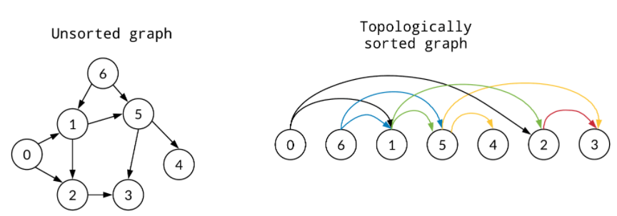
Topological Sort
In computer science, a topological sort or topological ordering of a directed graph is a linear ordering of its vertices such that for every directed edge from vertex u to vertex v, u comes before v in the ordering.
Topological sorting of only directed acyclic graph (DAG) is possible.

Slide 3
Topological Sort
There can be many topological sortings possible of given directed acyclic graph. Starting vertex should be the vertex where in degree is zero.
Applications :
Scheduling of jobs that are dependent on each other
Steps to follow while cooking , building houses etc
Pre-requisite course system like which course you need to study before understanding any particular course
and etc

Slide 4
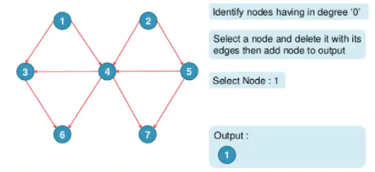
Topological Sort : Example

Slide 5
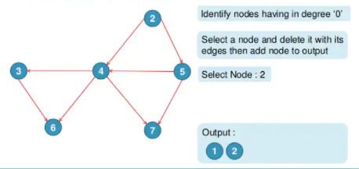
Topological Sort : Example

Slide 6
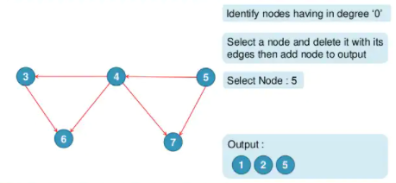
Topological Sort : Example

Slide 7
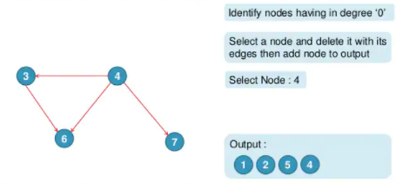
Topological Sort : Example

Slide 8
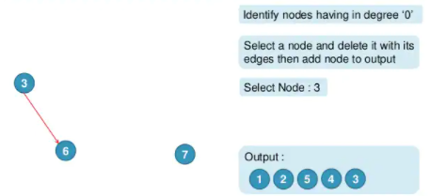
Topological Sort : Example

Slide 9
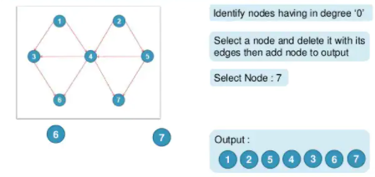
Topological Sort : Example

